Slide 1

Briefing Document

Slide 2
Company Overview

Slide 3
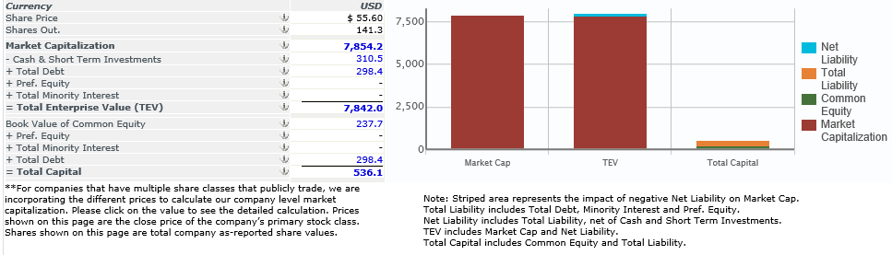

Company Overview
Xero: Xero is one of the fastest growing software as a service companies globally. It leads the New Zealand, Australian, and United Kingdom cloud accounting markets, employing more than 2,500 people. Forbes identified Xero as the World’s Most Innovative Growth Company in 2014 and 2015.
Xero’s software-as-a-service business model, where software is hosted securely on the internet, allows Xero to address the large and fragmented small business market. Additions and extensions to functionality are developed in response to the needs of new customers and new industries.
Founded in 2006, Xero listed on the New Zealand Stock Exchange in June 2007 and the Australian Securities Exchange in November 2012. In 2018 Xero consolidated its listing on the ASX and was included in the S&P/ASX 100 index.
Capitalization (February 3, 2020)

Slide 4
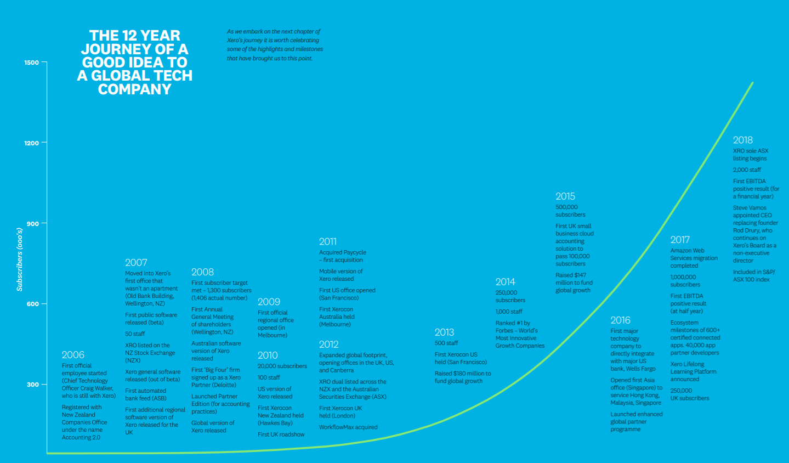
Company Overview (continued)
Source: Annual Report (2018)

Slide 5
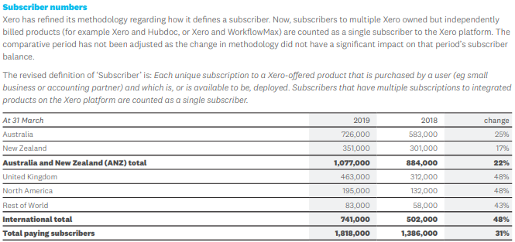
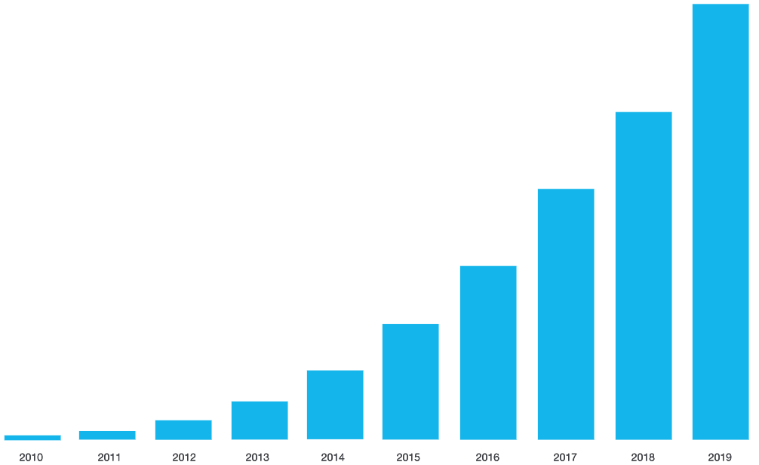
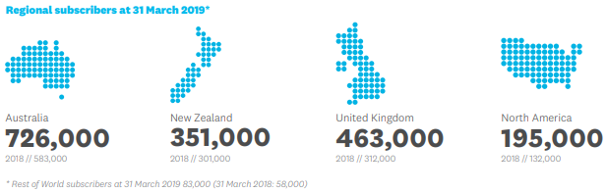
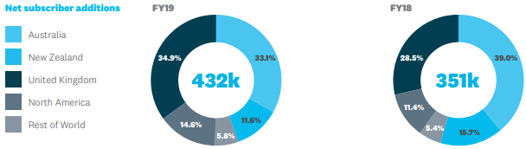
Company Overview (continued)
Source: Annual Report (2019)

Slide 6
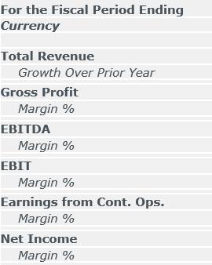
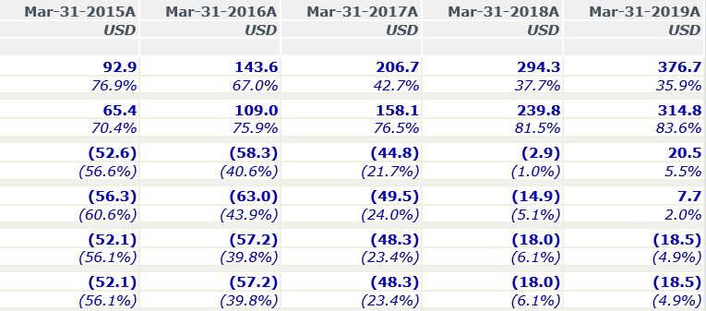
Company Overview (continued)
Financial Performance
Source: CapitalIQ

Slide 7
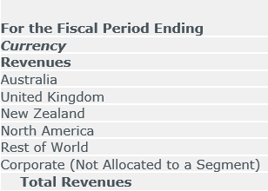
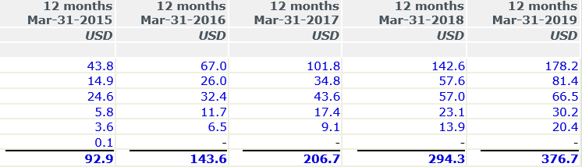
Company Overview (continued)
Geographic Segment Performance
Source: CapitalIQ

Slide 8
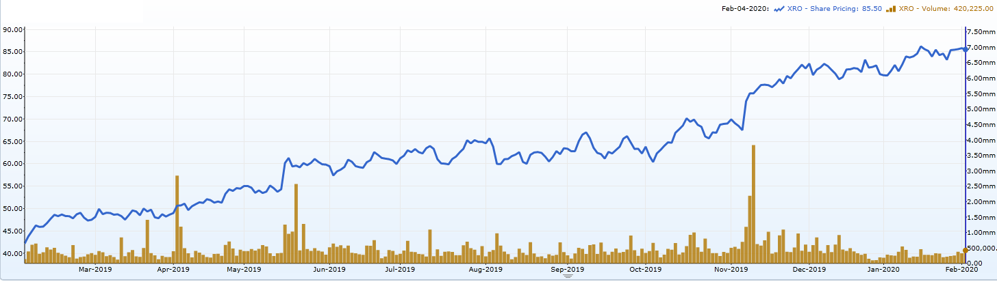
Company Overview (continued)
Company Stock Performance
Source: CapitalIQ

Slide 9
Board Bios

Slide 10
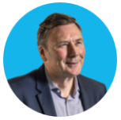
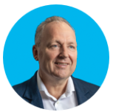
Board Bios
David Thodey AO
Chairman
David Thodey AO is a business leader focused on innovation, technology and telecommunications, with more than 30 years of experience creating brand and shareholder value. He is currently chairman of Australia’s national scientific research agency, the Commonwealth Scientific and Industrial Research Organization (CSIRO) , and Tyro, Australia’s only independent EFTPOS provider, a non-executive board director of Ramsay Health Care, a global hospital group; and of Vodafone Group Plc.
David had a successful executive career as CEO of Telstra, a significant Australian telecommunications and information services company and as CEO of IBM Australia and New Zealand. In 2017, David was made an Officer (AO) in the General Division of the Order of Australia.
Rod Drury
Xero Founder / Non-executive Director
For more than a decade, Rod led Xero from humble beginnings with four employees working in a Wellington apartment to a global software business and S&P/ASX 100 company. Rod remains Xero’s largest shareholder. Rod started his career at Ernst & Young and went on to establish and lead a number of innovative technology businesses. Rod was an independent director on the NZX Board and the Trade Me Board. At the Deloitte Top 200 Awards in 2017, Rod was named Visionary Leader of the Year. He was named Ernst & Young New Zealand Entrepreneur of the Year in 2013, and is a member of the New Zealand Hi-Tech Hall of Fame.

Slide 11
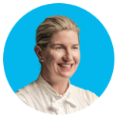
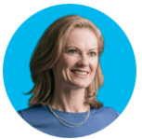
Board Bios (continued)
Lee Hatton
Lee has extensive commercial experience across New Zealand, Australia, the UK, and the US. After moving to Australia in 2012 to lead NAB’s Group Regulatory function, in 2015 Lee became the Chief Executive Officer of UBank where she is accountable for the business’s strategy and performance. Lee believes creating a growth culture, centerd on customers, is the true disruptor of companies, and she has led large distribution teams throughout her career leveraging this philosophy. Recognized for her collaboration abilities and experience blending technology innovation and financial services, Lee is also an executive director of NAB Ventures and a non-executive director of BLD Group Pty Ltd. Lee is involved in the community and enjoys mentoring individuals, especially in relation to the future of work.
Dale Murray CBE
Dale is a technology entrepreneur and growth-company advisor. Dale co-founded mobile pioneer Omega Logic in 1999, which co-launched prepay top-ups in the UK. She led the growth of top-up transactions to £450m within five years, generating net revenue of £25 million. After selling the company in a trade sale, she turned to investing and advising start-ups and won the British Angel Investor of the Year award in 2011. Dale is currently a Europe Beachheads advisor for NZTE, a non-executive director at The Cranemere Group Ltd, and a board advisor to Seedrs. She was formerly a non- executive director and Trustee for the Peter Jones Foundation and a non-executive director at Sussex Place Ventures and the Department for Business, Innovation & Skills. She served on the Business Taskforce on EU Redtape for the British Prime Minister in 2013.

Slide 12
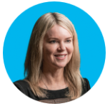
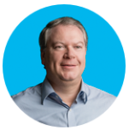
Board Bios (continued)
Susan Peterson
Susan is an experienced independent director on both ASX and NZX listed companies. She is currently an independent director of Trustpower, Vista Group, Property for Industry, and ASB Bank. Susan is a member of the New Zealand Markets Disciplinary Tribunal, was a past Ministerial Appointee to The National Advisory Council for the Employment of Women, and is a Board member of nonprofit Global Women (NZ). Susan is founding co-chair and a shareholder in fast-growing health and wellness start-up company Organic Initiative Limited.
Craig Winkler
Nominating Committee
Craig co-founded Australian small business accounting software provider MYOB in 1991. Craig built MYOB to be a popular business tool and brand which, in 2004, merged with Solution 6 to become Australia’s largest IT company. Craig joined the Xero Board in 2009. He now spends the majority of his time working in the philanthropic sector.

Slide 13
Executive Bios

Slide 14
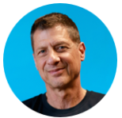
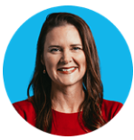
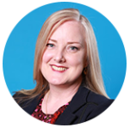
Executive Bios
Steve Vamos
CEO
Steve leads the global growth and performance of Xero. With more than 30 years’ experience in global technology and digital media, Steve has worked in leading international businesses including Apple, IBM and Microsoft. Steve led the growth of online media business Ninemsn from start-up to industry leader as the company’s CEO. Steve previously served on the boards of Telstra, David Jones and Medibank, and has an honors degree in civil engineering from the University of New South Wales, Australia.
Anna Curzon
Chief Product Officer
Anna leads Xero’s partner and product teams, spearheading product management, development, design, and product marketing to bring more exciting Xero features to partners and small businesses. Anna has a wealth of experience in online financial services and operations. Before joining Xero as managing director for New Zealand in 2016, Anna led internet banking at ASB and the digital first strategy at Spark. Anna has a bachelor’s degree and a postgraduate diploma in commerce from the University of Auckland.
Kirsty Godfrey-Billy
CFO
Kirsty leads Xero’s global financial team, driving financial outcomes, actively managing the group’s financial performance, optimizing the business's balance sheet and communicating the group’s strategic and financial priorities to key stakeholders, including investors. She also has management of Xero’s global facilities team. Kirsty is a Chartered Accountant with 25 years’ experience in the finance and technology sectors both in private practice and commercial technology roles. Kirsty holds a Bachelor of Commerce and Management degree from Lincoln University.

Slide 15


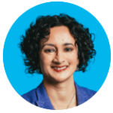
Executive Bios (continued)
Rachael Powell
Chief Customer Officer
Rachael is responsible for Xero’s customer success, people experience, marketing and communications functions globally. She has previously held positions in strategy, marketing, talent management and channel development across online and technology businesses. In her current capacity, she brings together her dual passions; delighting our customers and nurturing our people. Rachael believes that customer experience must resonate from the inside-out and advocates for positive engagement programs to effectively mobilise the business strategy at scale. She has a Masters in Applied Positive Psychology, a Masters in Business Administration, and a Bachelor of Business (Accounting and Marketing).
Mark Rees
CTO
Mark leads the platform, security, data and automation teams at Xero and is responsible for enabling Xero’s technology platform for growth and innovation. Before joining Xero, Mark was the chief technology officer for Microsoft New Zealand and the chief product and technology officer for Trade Me. Mark has a PhD and bachelor of science in chemistry from the University of Canterbury.
Chaman Sidhu
Chief Legal Officer & Company Secretary
Chaman leads Xero’s legal functions globally and has more than 20 years’ experience in legal operations, strategy, compliance, governance and risk management. She has previously worked as group general counsel and company secretary for Envato and Lonely Planet Publications. Chaman is dual-qualified in Australia and the US, and is a graduate of the Australian Institute of Company Directors.

Slide 16
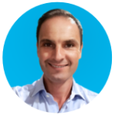
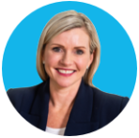
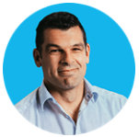
Executive Bios (continued)
Damien Tampling
Chief Strategy & Corporate Development Officer
Damien leads Xero’s global strategy and corporate development teams, and oversees Xero’s strategic planning activities through the Integration Management Office and the Project Manager Office. Prior to joining Xero, Damien spent 13 years at Deloitte in a number of senior executive roles. He holds an Australian Financial Services Licence (and its equivalent in Singapore), is a member of the Australian Institute of Company Directors, and holds a Bachelor of Business from RMIT University, Melbourne.
Nicole Reid
Chief People Officer - Acting
Nicole leads Xero’s people experience function globally. As an established human resources leader, she has more than 20 years’ experience in human resources strategy development and execution, delivering value-adding organisational people solutions and transformational change programmes. Nicole has worked across the financial services, technology and telecommunications industries for companies including AMP and Microsoft.
Craig Hudson
Managing Director, New Zealand & Pacific Islands
Craig is responsible for promoting the small business economy in New Zealand and the Pacific Islands and Xero’s relationships with government, financial institutions, and enterprise. Craig joined Xero in the UK where he led the business into market in Europe, the Middle East and South Africa. Prior to joining Xero, Craig played professional rugby in New Zealand, France, England and Wales.

Slide 17
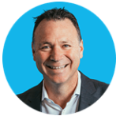
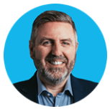
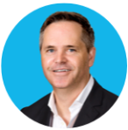
Executive Bios (continued)
Trent Innes
Managing Director, Australia & Asia
Trent is responsible for driving Xero’s next phase of growth in Australia and Asia. After joining Xero as national sales director in 2013, Trent was appointed managing director in 2016. He began his career as a certified practising accountant and has more than 17 years’ experience growing and managing major accounting and IT businesses. Prior to joining Xero, Trent managed the Microsoft Business Group in Australia.
Gary Turner
Managing Director, United Kingdom & EMEA
Gary is responsible for leading Xero’s operations across the UK, Europe, the Middle East and Africa. He has more than 20 years’ experience in the UK’s accounting software industry, and before joining Xero, he was the product group director for Microsoft Dynamics. Gary is a board advisor to Enterprise Nation and, since 2005, he has sat on the IT Faculty Technical Committee of the Institute of Chartered Accountants of England and Wales.
Tony Ward
President of Americas
Tony is responsible for expanding Xero’s businesses in the Americas. He has 20 years of experience in senior leadership positions with global technology companies, including Microsoft Australia, LinkedIn, Spark, SurveyMonkey and Dropbox. He’s also founded a successful cloud-based start up, Business365, aimed at small businesses. Tony holds a Bachelor of Arts from the University of Manitoba and a Bachelor of Commerce from the University of Auckland and is a member of the Australian Institute of Company Directors.

